Slide 1
GCRIS
GCRIS is a research and performance evaluation information system that allows searching and discovering all research outputs at the University, associating these outputs with researchers, providing advanced reporting with different metrics, and supporting institutional strategic decisions.
In addition, it is an open institutional academic archive at international standards that brings together and organizes all kinds of academic outputs related to research activities and allows sharing with the entire scientific world.

Slide 2
.
It is compatible with open access infrastructures such as Euro Cris and OpenAIRE.
It is automatically indexed by systems such as Google Scholar, Base, unpaywall, Tubitak harman.
This feature increases the visibility of the institution's research outputs and researchers.

Slide 3
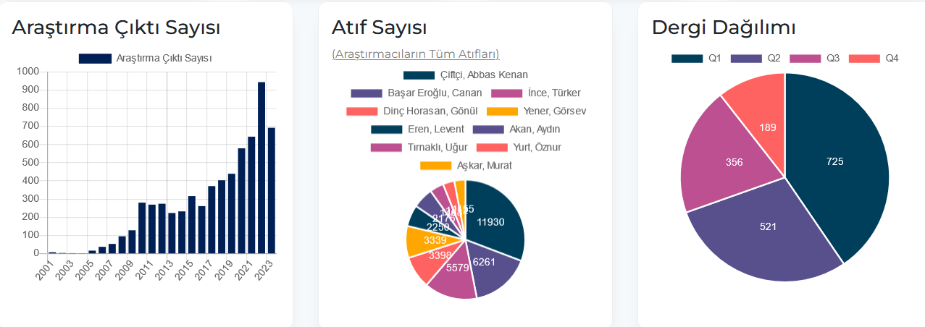
On the Homepage
Number of research outputs by years,
Distribution of researchers according to citation numbers,
Graphs showing the distribution of institution publications according to Q values can be found.

Slide 4
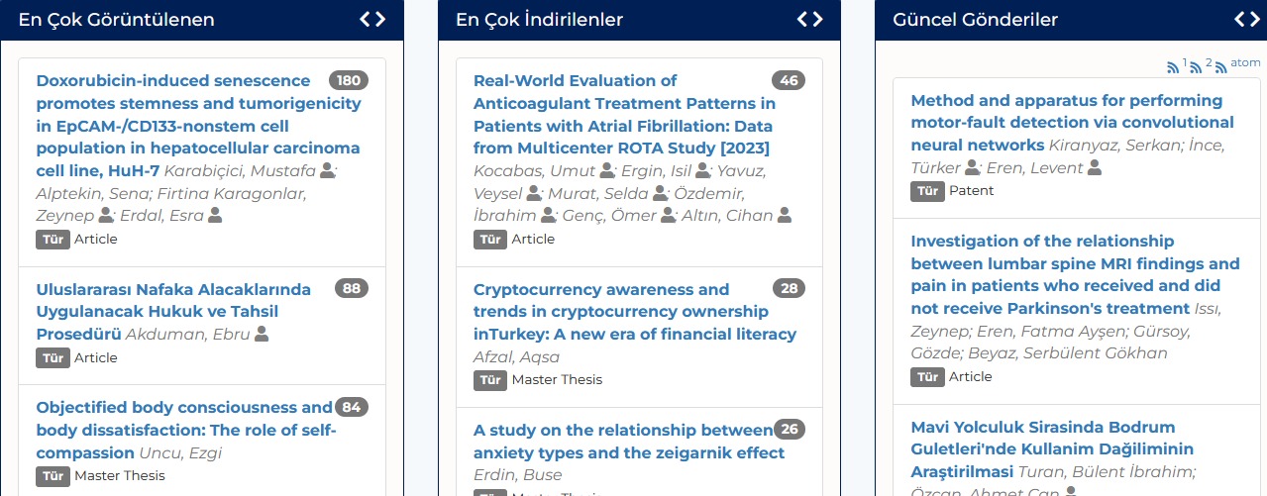
The homepage contains the most viewed, most downloaded and current posts.

Slide 5

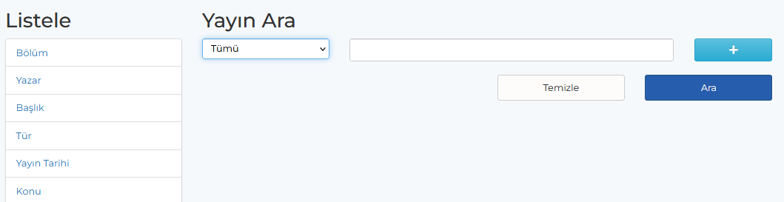
The GCRIS database has 4 main modules
1- Publications Module: Publications module offers various discovery options for all publications belonging to the institution.
By using the search box, publications can be searched with different metrics.

Slide 6
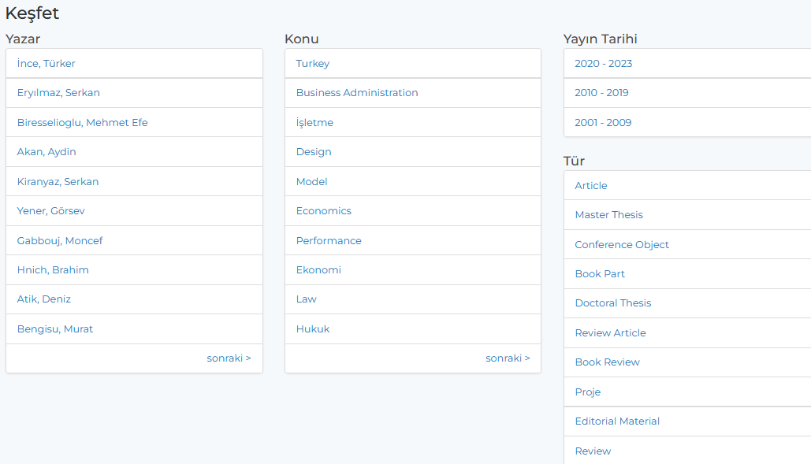
In addition to search box, publication lists can be easily accessed according to authors, topics, date ranges and publication types with the Quick discovery facility.
When clicked on the article

Slide 7
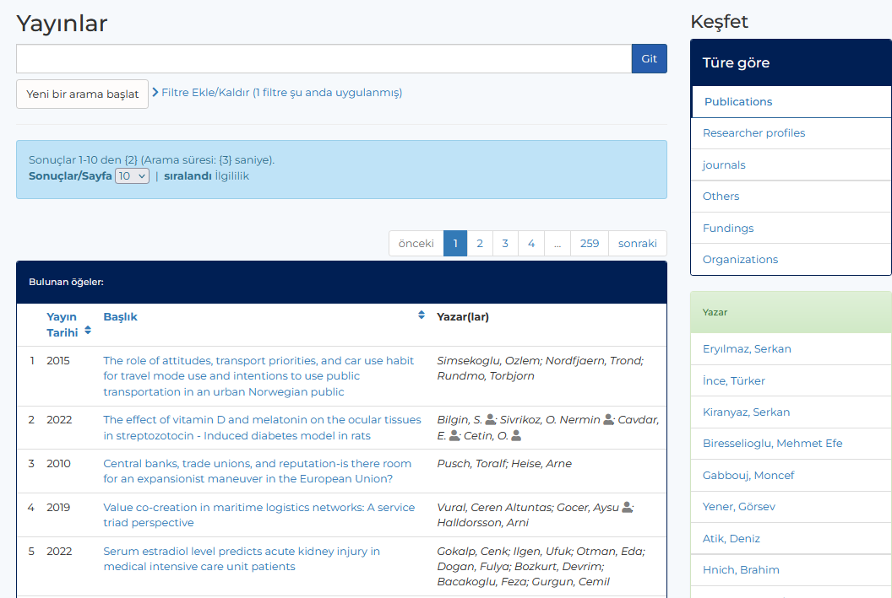
.
details of the article can be seen

Slide 8
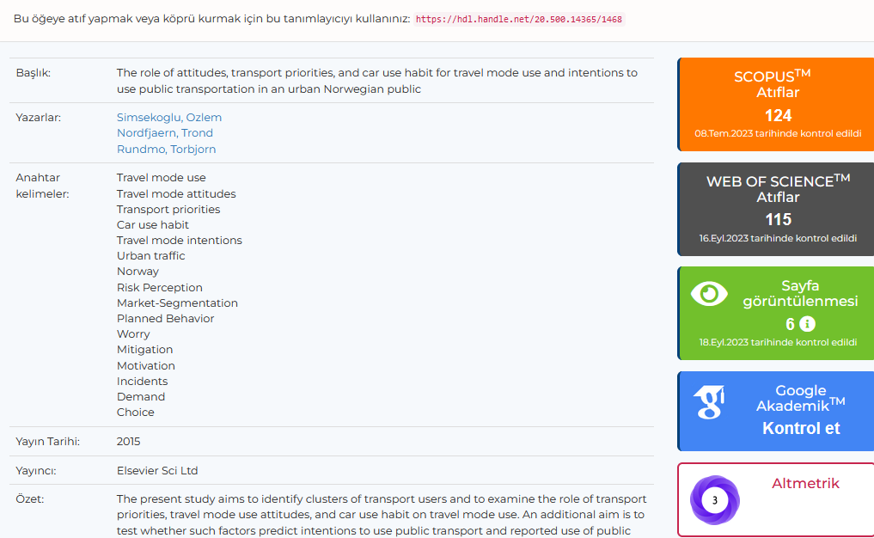
The number of citations from WOS and SCOPUS, the number of times the article has been viewed and downloaded in the system, and the Google Scholar link and altmetric information are displayed.

Slide 9
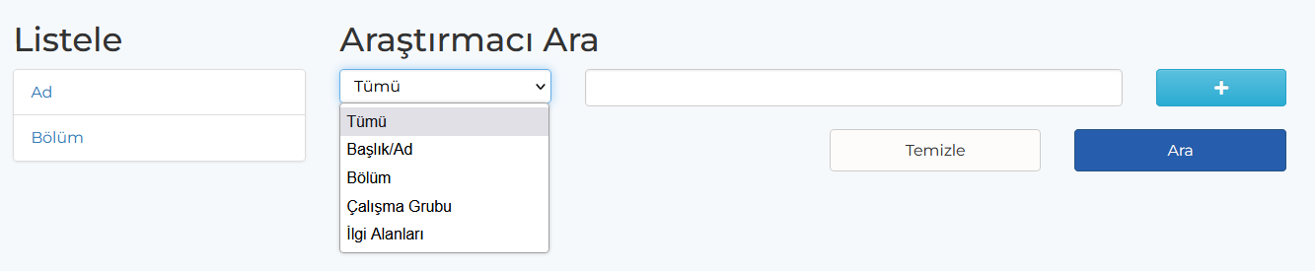
2- Researchers Module
All researchers in the institution can be listed by name or department, and researcher profiles can be examined.
Various metrics can also be searched using the search box.

Slide 10
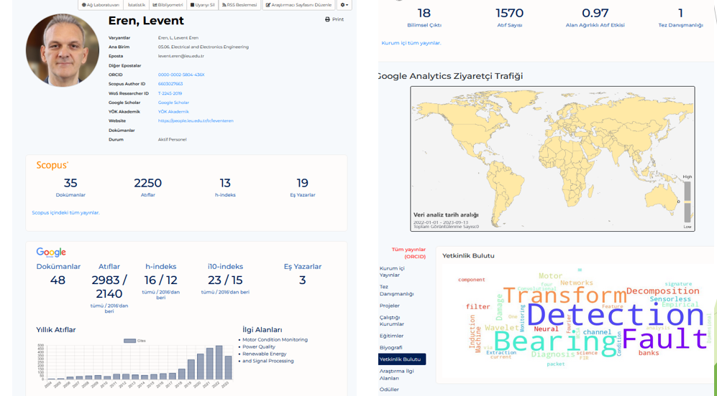
Researcher Profile
In the researcher profiles, bibliometric information such as the number of publications and citations, H-index, and field-weighted citation effect can be accessed.

Slide 11
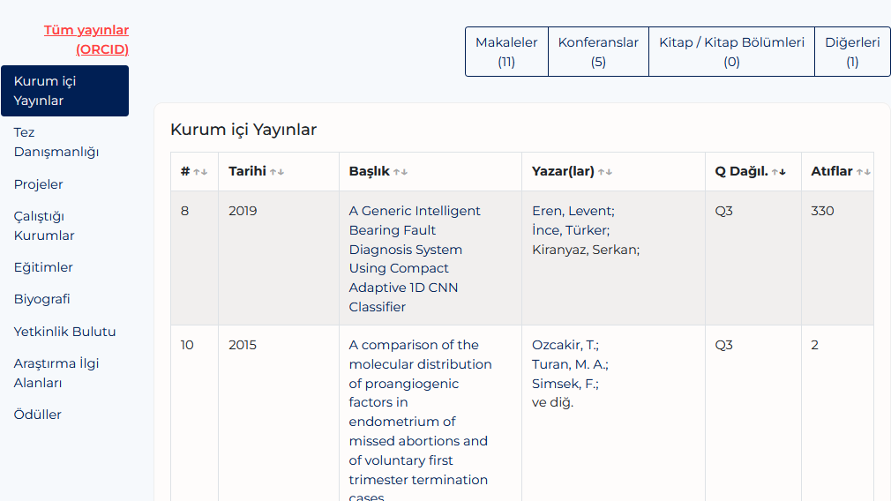
In the researcher profiles, publications can be filtered by types
Publication date, number of citations, Q value of the journals can be accessed

Slide 12
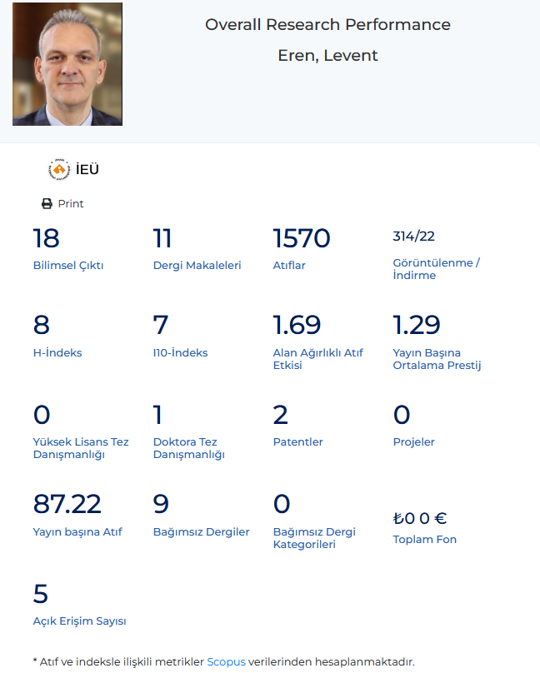
Researcher's all scientific outputs can be examined from the Bibliometrics area.

Slide 13
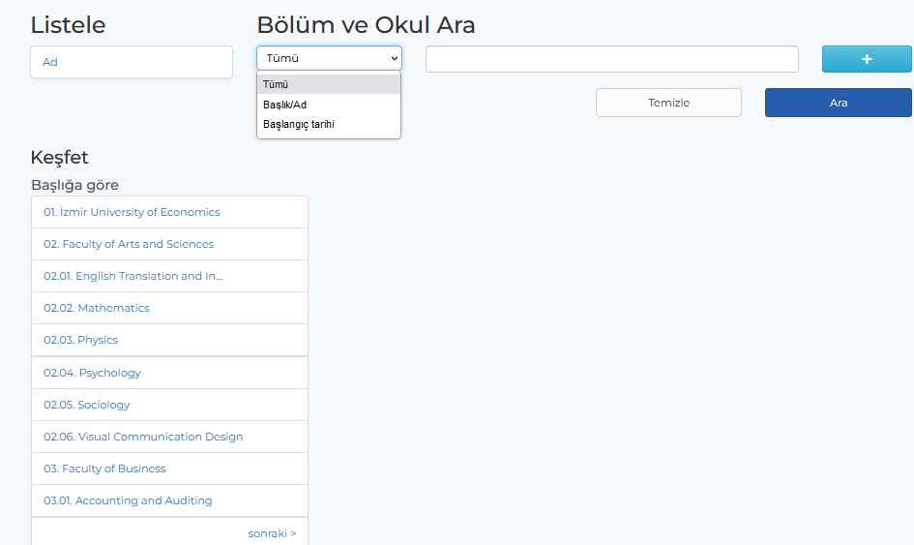
3-Unit Module
Department-based analysis is offered.
All departments are listed in this field, or a department-based search can be made with the search box.

Slide 14
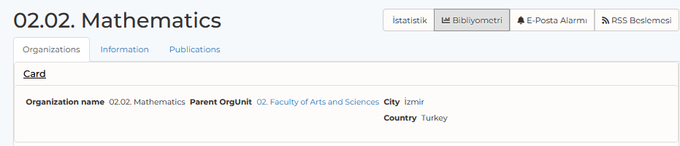
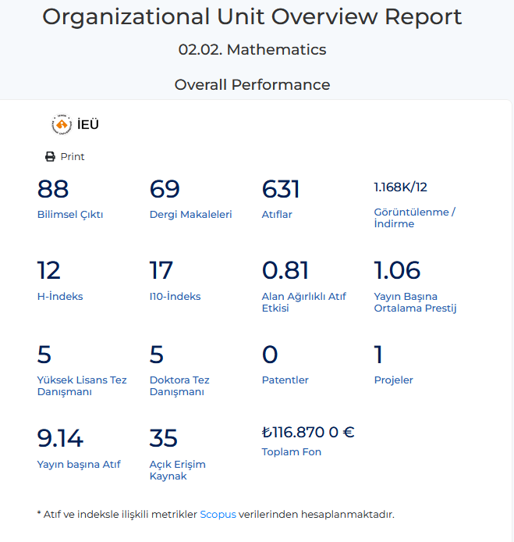
When the Bibliometrics button is clicked, all the charts and lists that we see in the Researcher profile can be accessed on a departmental basis.

Slide 15
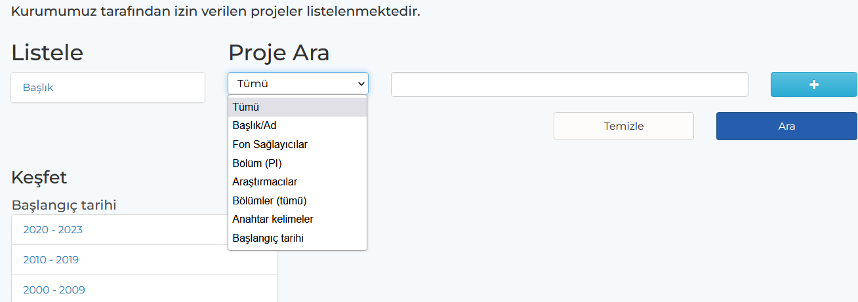
4-Projects Module
GCRIS includes not only publications, but also different types of research components such as projects, equipment, awards and data sets, which include the entire ecosystem of the University.
The number of projects by year and publications regarding projects can be explored and examined.

Slide 16
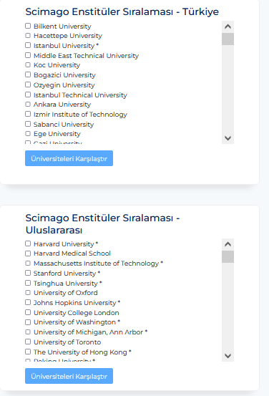
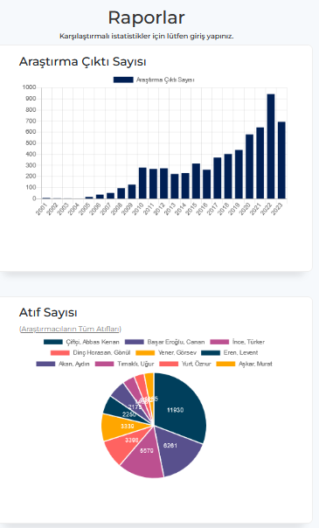
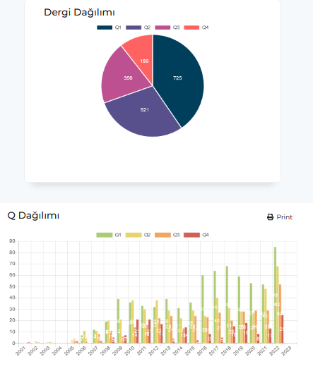
Under the Reports menu, general graphics of the institution's scientific outputs can be accessed and comparisons can be made between domestic and foreign universities.

Slide 17

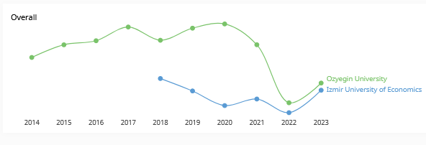
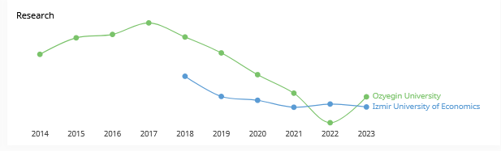
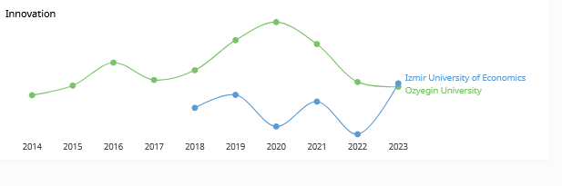
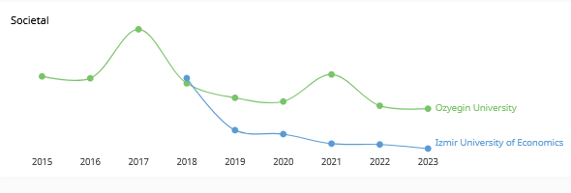
.

Slide 18
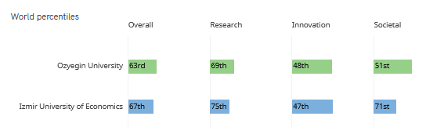
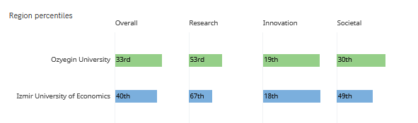
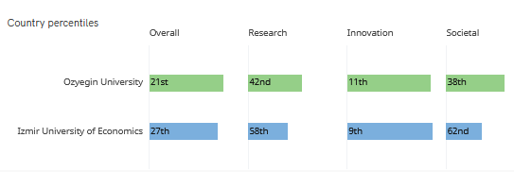
.

Slide 19
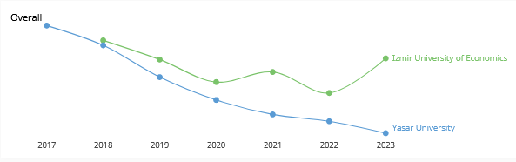
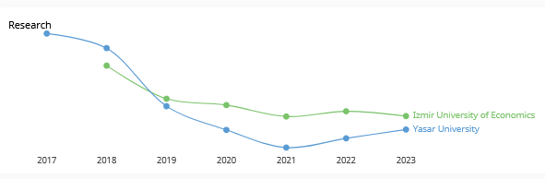
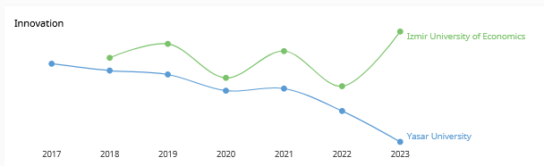
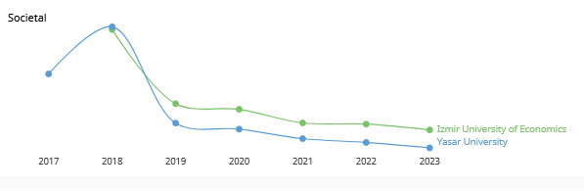
.

Slide 20
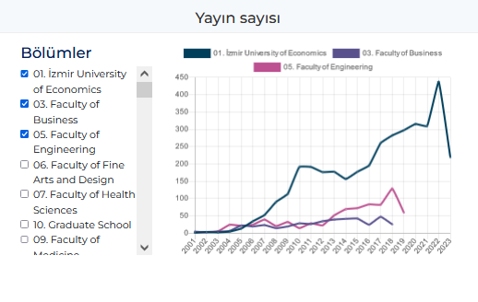
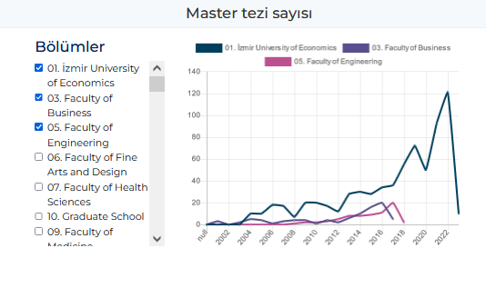
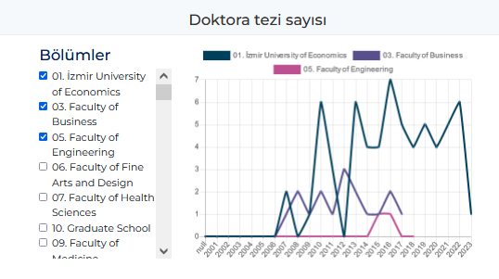
Provided that the GCRIS database is logged in;
Publication numbers, master's and doctoral theses numbers can be easily compared on a departmental basis in the reports menu.

Slide 21
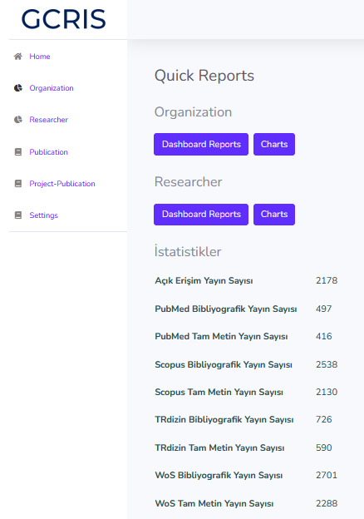
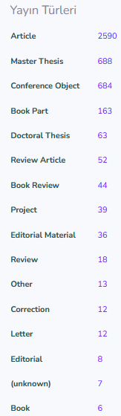
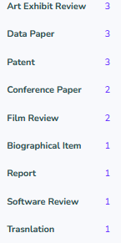
The system has an advanced reports module that supports the creation of corporate strategic plans and making managerial decisions, and reports are created.

Slide 22
In order to ensure the use of the GCRIS database throughout the University, academic / researcher profile percentages need to be developed and enriched with your support.
In addition, publications with IUE addresses other than WoS, Scopus, TRDizin and PubMed indexes must be added to the system.

