Slide 1
GCRIS
GUIDE FOR ENTERING AND EDITING RESEARCHER PROFILE

Slide 2
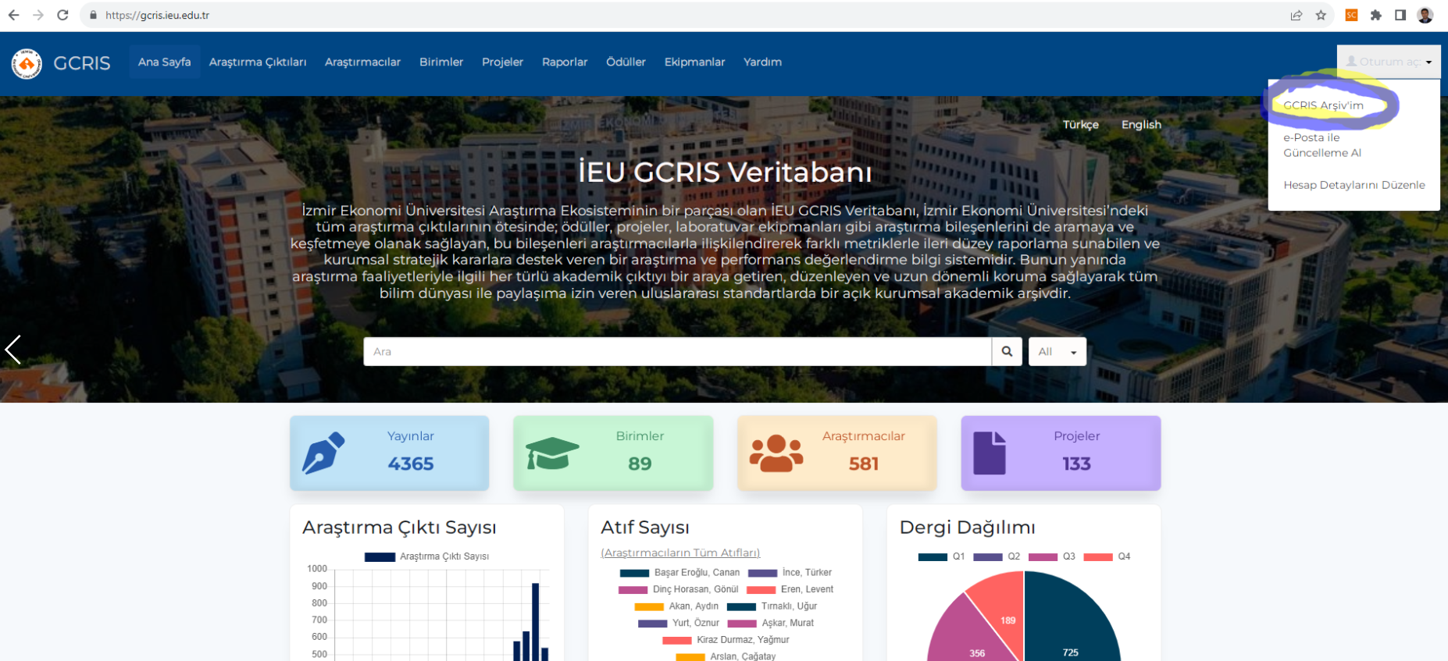
The steps to log in to the IUE GCRIS Profile are as follows:
Step 1: After logging in to IUE GCRIS (https://gcris.ieu.edu.tr) address, click on the Login button at the top right of the screen and select the My GCRIS Archive option.

Slide 3
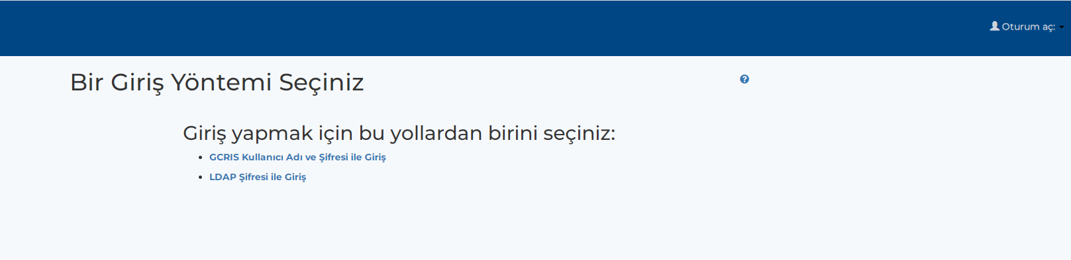
Step 2: A page with two options asking for username and password information will appear on the screen. You can login to the profile page using either of the two options.
For both options, username (name.lastname@ieu.edu.tr) and password information can be created from the forgot my password option
You can change your password once you log in.

Slide 4
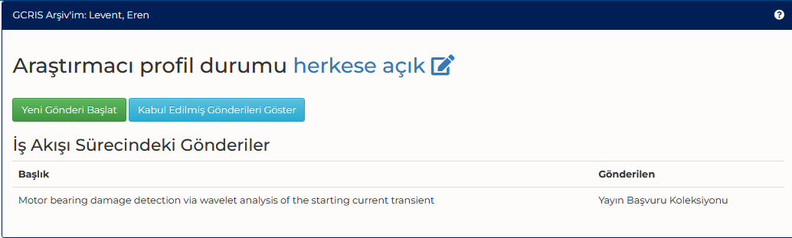
Step 3: Click on the My Gcris Archive field and display the "Researcher Profile Status" as public on the screen below. Click on the public button.

Slide 5
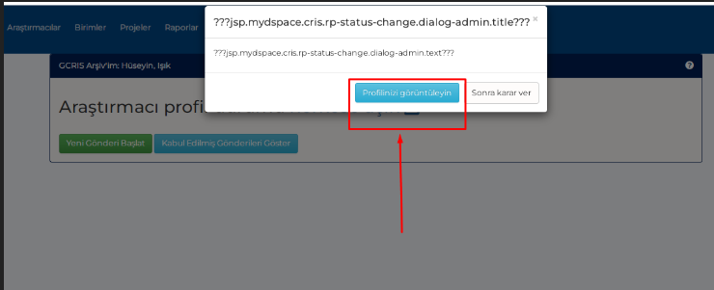
Step 4: Select the "view your profile" option on the screen that opens.
Profilinizi görüntüleyin butonuna tıklayınız

Slide 6
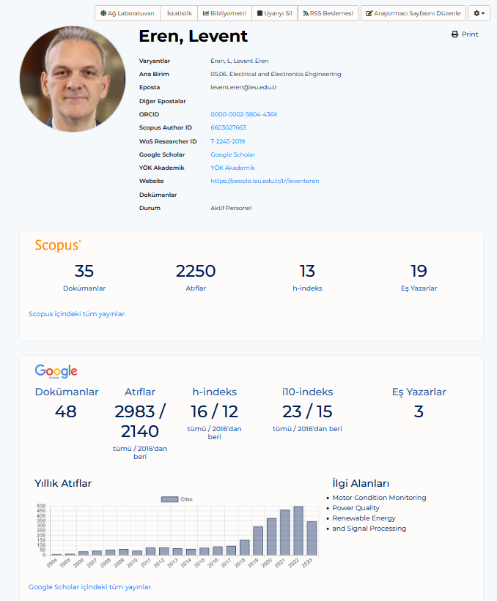
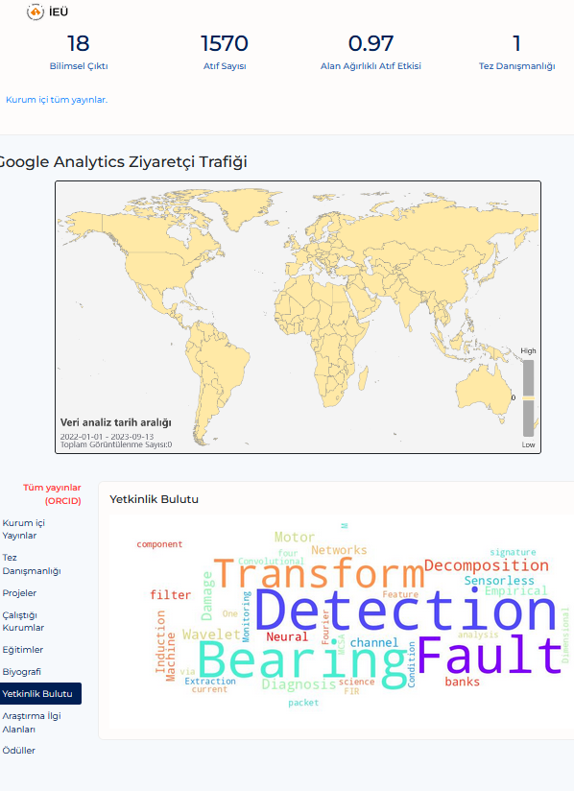
Step 5: The researcher is directed to the page with information about their profile. Basic information about the researcher can be viewed here. At the same time, in addition to bibliometric analysis, it contains information such as scientific outputs in GCRIS, number of citations, field-weighted citation impact, thesis consultancy, projects carried out, educational status and biography.

Slide 7
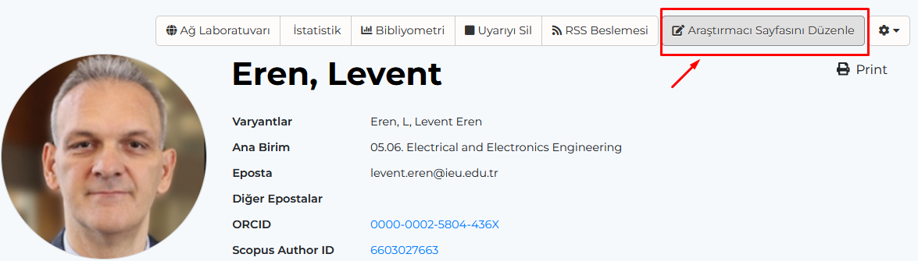
Step 6: GCRIS Researcher Profile Editing Steps
Click on the Edit Researcher page button.
A Researcher Data Form opens with fields to be filled in for the researcher. The fields labeled in red on this page are mandatory fields, which take values from the CERIF semantics with a link to the metadata. There are various edits that the researcher can make here. The researcher fills in the following data here;
Different spellings of their name,
Institution, department information,
Information on their own website, e-mail address,
ORC-ID, Scopus Author ID, WoS Researcher ID and Google Scholar links,
Institutions they worked for,
Education details (Day-Month-Year)
If there are additions to their biography, they can update these additions.
Each field to be filled in here will increase the visibility of the researcher profile and the accessibility of publications; therefore, it will contribute to the citation of publications and the visibility of the institution.
After the edits and additions in the relevant fields are made, the profile is updated by clicking the "Save Changes" button at the bottom right of the screen.

Slide 8
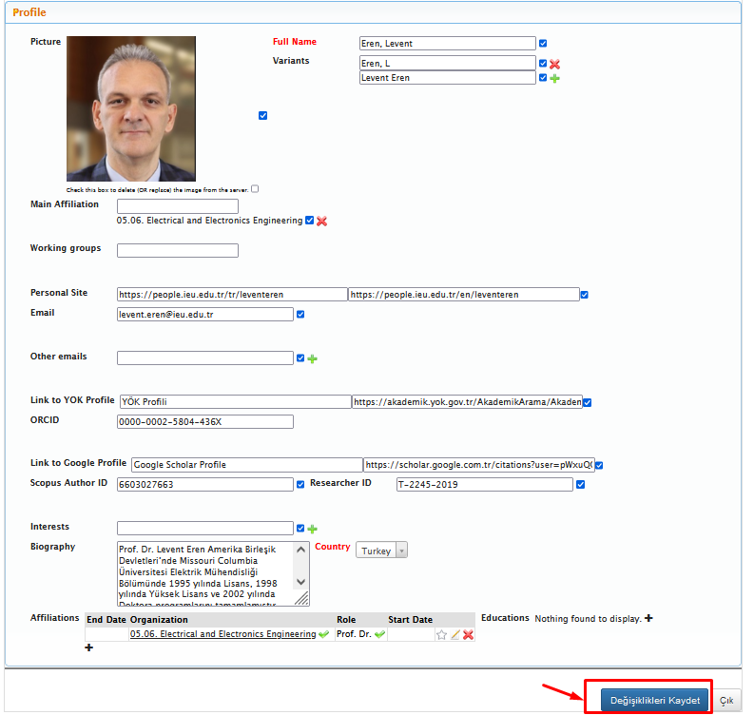
Click the "Save Changes" button.

Slide 9
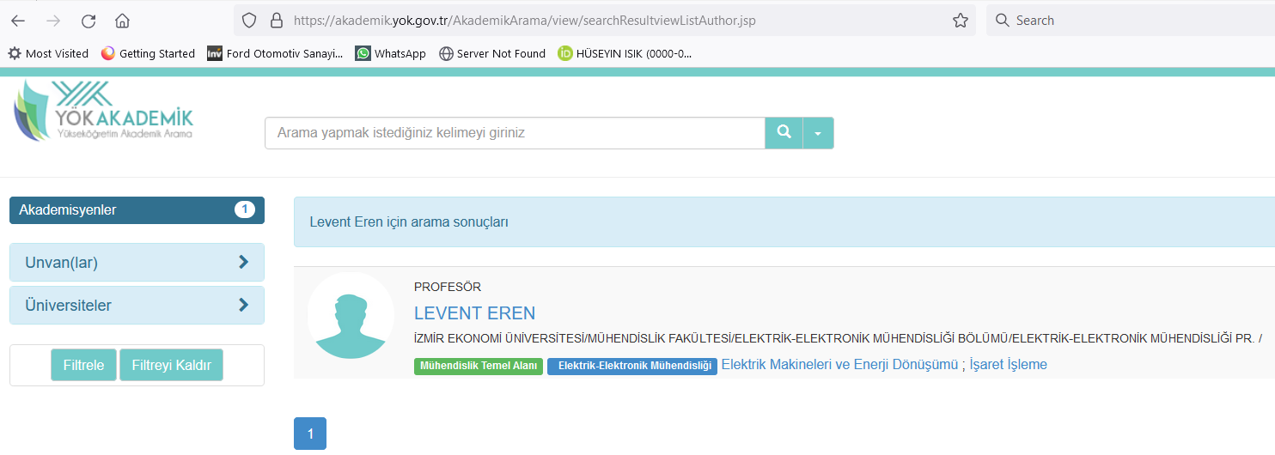
Adding YOK Profile Info
Search for a name at https://akademik.yok.gov.tr/AkademikArama/

Slide 10
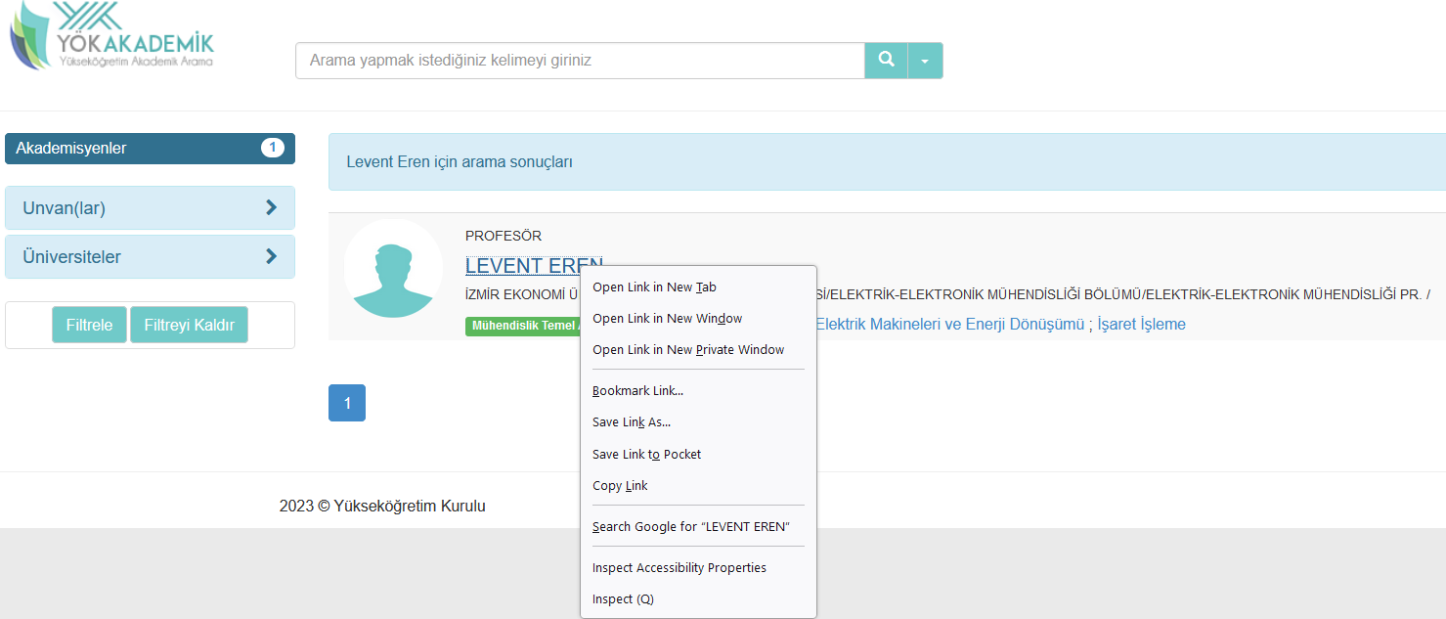
Right click the name.
Click the Inspect button.

Slide 11
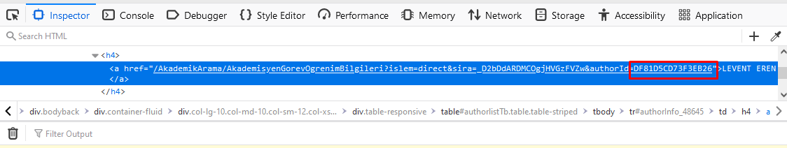
.
Copy the ID number in the href section.

Slide 12
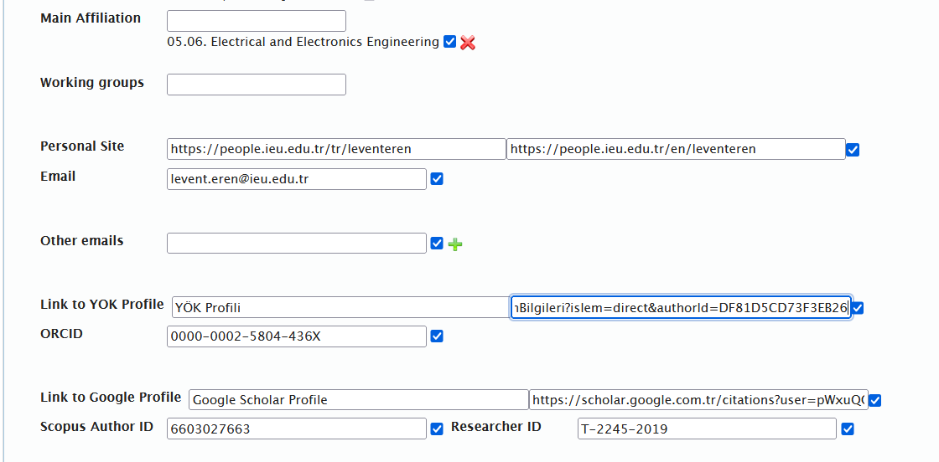
Adding YOK ID
Paste the ID number in this field.

Slide 13
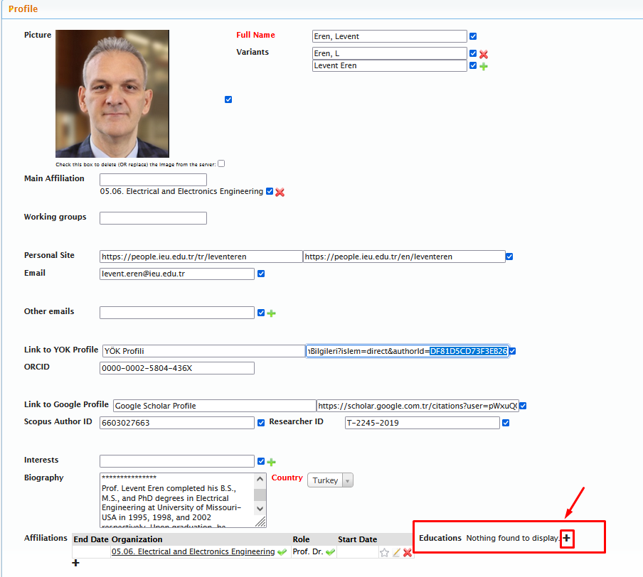
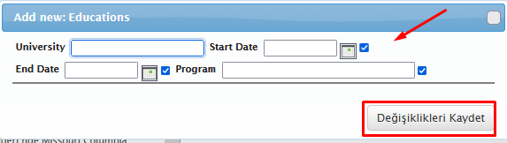
Adding Education Info
Fill in the education info.
(e.g., 13-07-2001)
Click the Save Changes button.
To add education info, click + sign on the education button.

Slide 14
Creating SCOPUS ID and WoS ID and Establishing ORCID Connection
All academics are required to create Scopus ID and WoS ID. If these IDs are already available, their ORCID connection must be established.
If there is no previous record in Scopus or WoS for ORCID connection, click the Sign-In button for a one-time registration and click the «Connect to ORCID» to ensure a connection for all index publications.
Thus, publications will be visible in GCRIS regardless of the index they are included in.

Slide 15
For any questions
Please send an e-mail to samet.celiktas@ieu.edu.tr
or
Call ext:8389.

