Slide 1
GCRIS
ADDING PUBLICATIONS
.

Slide 2
.
GCRIS database, which is a part of the research ecosystem of Izmir University of Economics, is an open institutional academic archive system at international standards that automatically compiles all research outputs by Izmir University of Economics and included in WoS, Scopus, TRDizin and PubMed indexes every month.
If your publication with the address of Izmir University of Economics is located somewhere else other than WoS, Scopus, TRDizin and PubMed indexes and you want this publication to be included in the GCRIS database, you must perform the following steps:

Slide 3
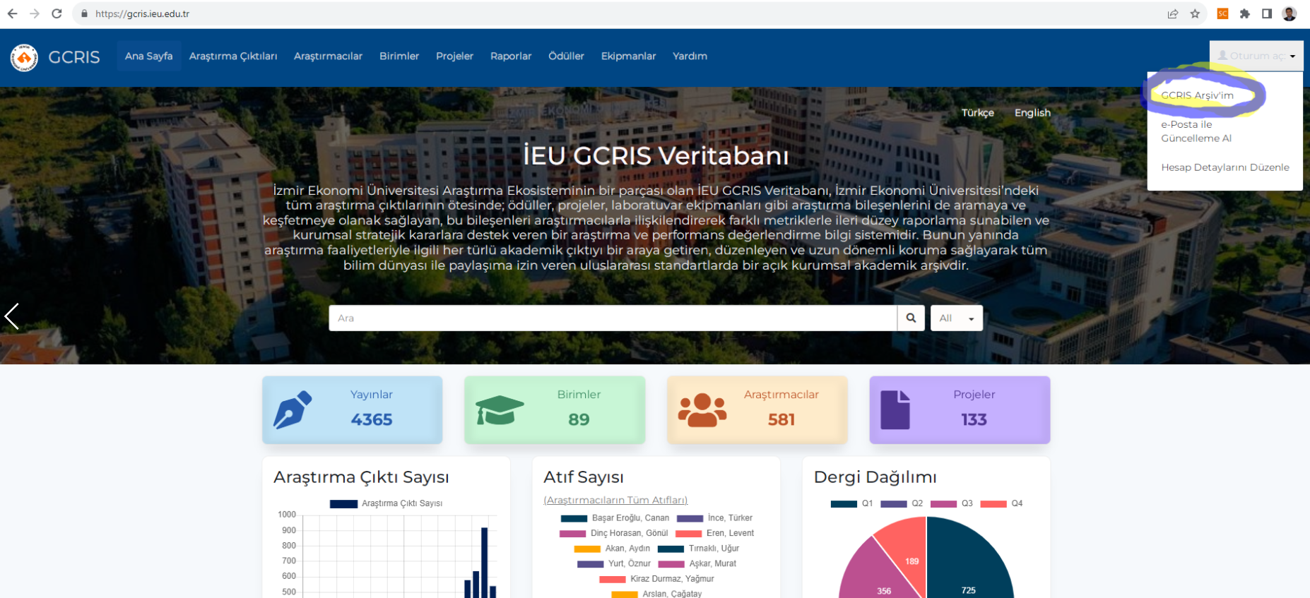
The steps to follow to upload a publication:
Step 1: After logging in to IUE GCRIS (https://gcris.ieu.edu.tr) address, click on the Login button at the top right of the screen and select the My GCRIS Archive option.

Slide 4
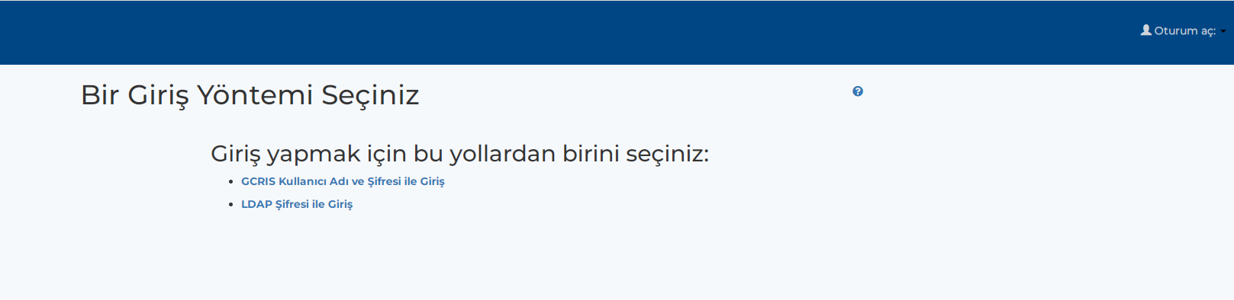
Step 2: A page with two options asking for username and password information will appear on the screen. You can login to the profile page using either of the two options.
For both options, username (name.lastname@ieu.edu.tr) and password information can be created from the forgot my password option
You can change your password once you log in

Slide 5
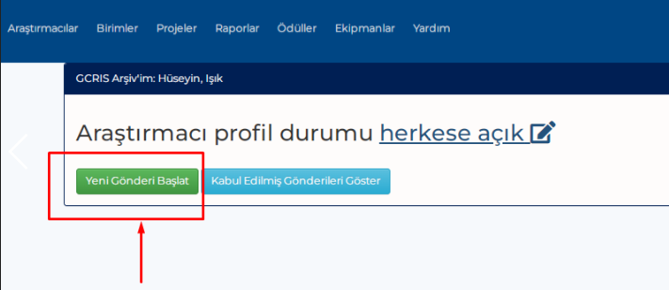
Step 3: Click on the My Gcris Archive field and click on the "Start New Post" button on the screen below.
Click on the start new post button to upload.

Slide 6
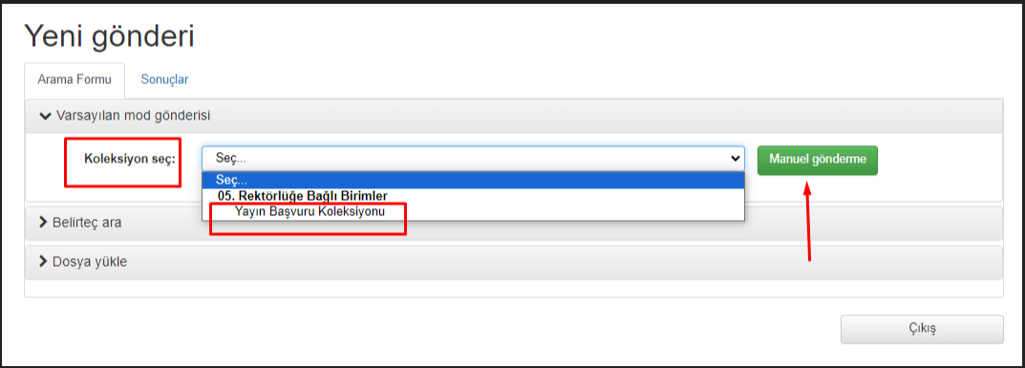
Step 4: On the screen that opens, click "Default mode", select "Publication Application Collection" from the "Select" field and press the Manual submission button.

Slide 7
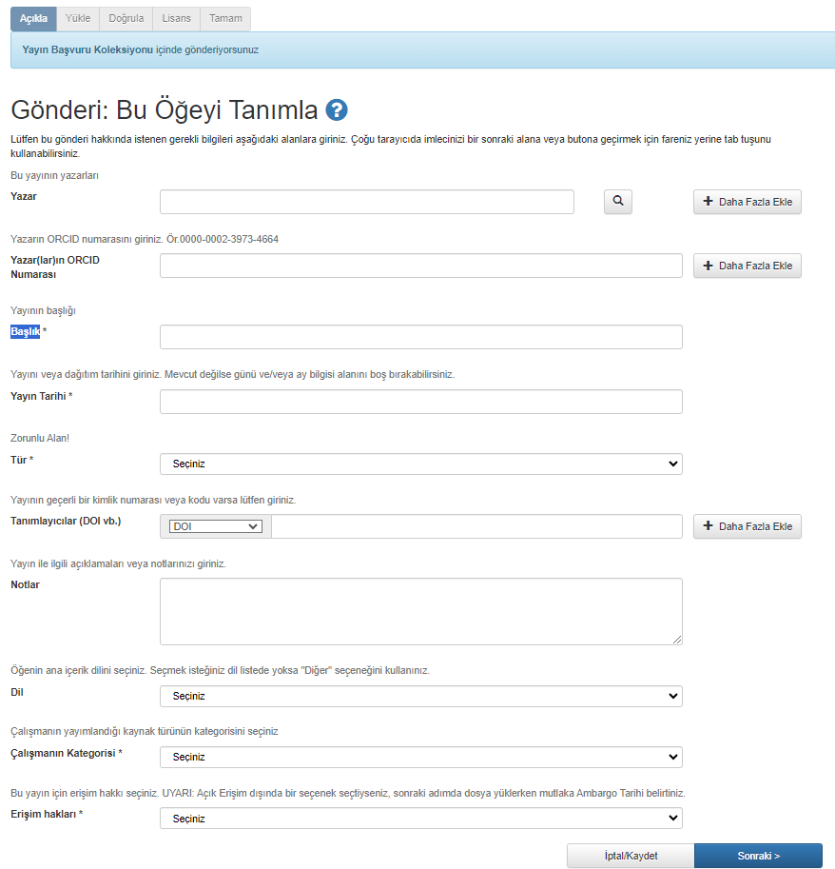
Step 5: After filling out the mandatory fields on the screen, click the «Next» button and pass the Upload, Verification, License and OK pages are one by one.

Slide 8
.
The metadata of the added records will be checked by the library, and approval will be made after completing any missing sections.

